Slide 1


Online Shopper
Purchasing Intention
Presented by Atlanta Rapid Miners

Slide 2
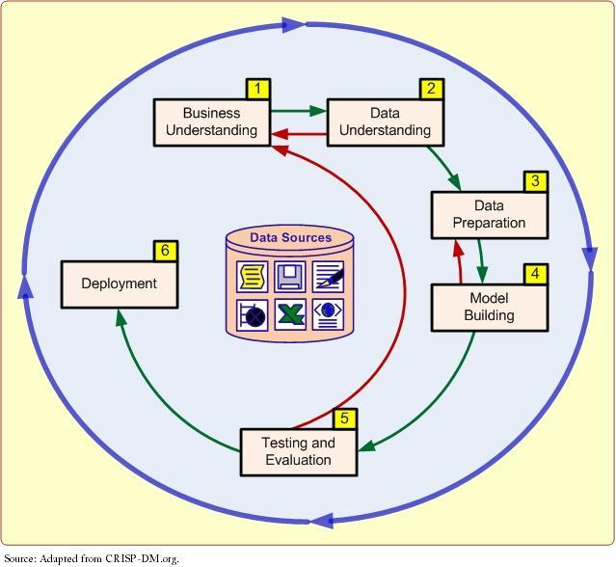
Our Process: The CRISP Data Mining Framework
Notes:
- Babs

Slide 3
Business problem: How can we engage our customers based on their purchase intention to maximize profit?
The problem in e-commerce
Our solution
Low Conversion Rate
E-commerce websites today tend to have a very low conversion rate of 5-15%
Traffic is not usually a problem: More visitors search for different products without ever buying them
Predict customer intention
Predict if a customer is going to buy or not as soon as they visit the website and target them while they are still in the session as per their segment
Why target while still in session?
Companies tend to e-mail non-purchasing customers a few hours (or days) after they end their session with offers
A delay in messaging can cause customers to lose interest. Providing offers (almost) instantly, we can convert customers who did not originally intend to purchase
Customer Retention
With increasing online competition, customers tend to compare products across platforms and purchase those with a mix of low prices and high ratings
Business Understanding
Evaluation
Deployment
Data Understanding
Data Preparation
Modelling
3
Notes:
Thanks, Barbara!
Before we dig into what we’re aiming to do, let’s understand what problems exist in the world of e-commerce today
First, most websites have a conversion rate of 5-10%, which means that only 5-10 of 100 visitors end up making a purchase. This is a fairly low rate, but varies from platform to platform
Second, increasing competition has made customer retention tough. Consumers tend to compare prices and product ratings across different platforms before making a purchase
So, how can we solve, or at least reduce some of these problems? By predicting whether a customer is going to make a purchase or not, we can target them while they are still in their session!
Some might wonder, why not just wait and see if they make a purchase or not? A delay in messaging can cause customers to lose interest and decrease their likelihood to convert even if we provide them offers a couple of days, or even hours later.

Slide 4



Segmenting our customers based on their Intention
Marketing Strategy
Barbara
Upselling
Can be casual or frequent shopper
Cross-Selling
Intention
Buy
Routinely checks favorite shopping sites with a plan to purchase
May or may not have a specific product in mind
AOV Increase
Goal: We want to encourage this segment to purchase more!
Marketing Strategy
Patrick
Cross-Channel Strategy
Explores but doesn’t purchase
Intention
Browse
Frequently browsing on the website but never makes a purchase
Tends to have a high bounce rate or exit rate
Impulse Purchase
Goal: We want to encourage this segment to make a purchase after browsing
Business Understanding
Evaluation
Deployment
Data Understanding
Data Preparation
Modelling
Notes:
Okay, so what if are able to predict a customer’s intention to purchase?
Well, let’s think about how knowing the intention of our customer can help us maximize revenue.
Different customers have different needs, and so we have identified two of the most common types, or segments of customers: Buyers…and Browsers
Buyers are the group of customers who have an intention to buy, but may or may not have a specific product in mind when they start their session. By using strategies such as Upselling, which means encouraging a customer to buy a more premium/expensive product, or Cross-selling, which refers to encouraging a customer to buy additional products with their originally intended products, we can maximize our Average Order Value, and hence Revenue
Browsers are the group of customers who tend to explore products but do not intend to make a purchase. By using strategies such as Impulse purchase, which means offering exclusive discounts for a short period of time, we can lure browsers to make purchases even if their original intention was not to make one.

Slide 5
Data Understanding
Data Source and Description
Online Shoppers’ Purchasing Intention dataset provided by UCI Machine Learning Repository
Includes 12,330 instances of customer characteristics, behaviors, and purchase decisions. Each instance belongs to a different customer.
Contains 18 attributes: 10 numerical and 8 categorical.
There are no missing values or anomalies (such as negative values)
The Revenue attribute is used as the target variable: FALSE refers to No Purchase, TRUE refers to Purchase
Independent Variables
Ideal but Unavailable Information
Page Type and Duration (Continuous)
Google Analytics Metrics (Continuous)
Information on multiple sessions for each customer, so that it is possible to analyze the willingness to purchase at different timeframes of each customer’s journey
Informational pageviews
Informational duration
Product pageviews
Product page duration
Bounce Rate
Exit Rate
Page Value (in USD)
Time Information
Visitor Characteristics (Categorical)
Special Day (Continuous)
Month (Categorical)
Weekend (Categorical)
Operating Systems
Browser
Region
Traffic Type
Visitor Type
Business Understanding
Evaluation
Deployment
Data Understanding
Data Preparation
Modelling
Notes:
The dataset we have is the online shoppers' purchasing intention dataset from UCI Machine Learning Repository. This dataset includes 12,330 instances of customer characteristics, behaviors, and purchase decisions. This dataset has 18 attributes, 10 numerical and 8 categorical. We use the revenue attribute here as the target variable. If the revenue is TRUE, it means the customer purchased. If it's FALSE, it means there's no purchase. The 17 independent variables we have can be divided into 4 categories. Page Type and Duration, Google Analytics Metrics, Time information, and Visitor Characteristics. Notice that for this dataset, each instance belongs to a different customer, so it's impossible for us to do analysis on different time points for one customer. If we have information on multiple sessions for each customer, we will be able to analyze the willingness to purchase at different timeframes of each customer's journey. - Jie

Slide 6
Data Preparation and Cleaning
Up-sampling minority class
Feature selection and engineering
Step 1:
Upsampling
Minority Class
Step 3: Removing Leakage & Feature selection
Our target variable, Revenue, is slightly imbalanced. We have used randomized up-sampling to change the distribution by up-sampling the minority class (From 85%-15% to 70%-30%)
We have excluded leakage variables such as duration and pageviews and will restrict our predictions to the time point when user starts the journey.
We also took the average of Bounce rate and Exit rate as they represented similar information in most cases
Step 2: Converting Categorical to Dummy variables
Step 4: Variable Transformations
Dummy variables for non-binary categories
Monotonic Transformations
Our categorical variables are unordered. It is imperative that we change them to multiple dummy variables using pandas.
We tried our models with and without transformed variables. Variables that had a skewed distribution were transformed using logs,sq roots and cuberoots. This was an iterative process which involved calibrating multiple models.
Business Understanding
Evaluation
Deployment
Data Understanding
Data Preparation
Modelling
Notes:
- Jie

Slide 7
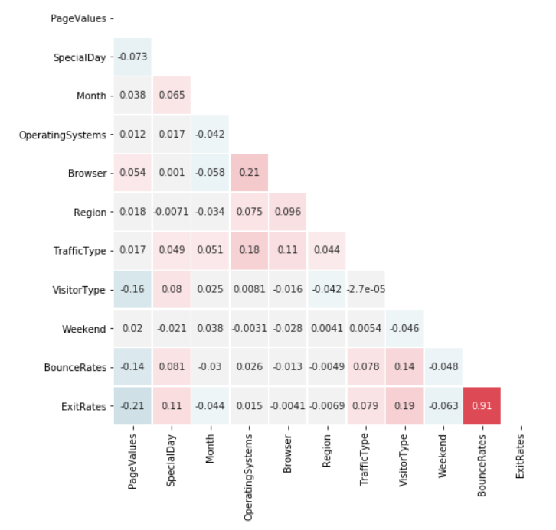
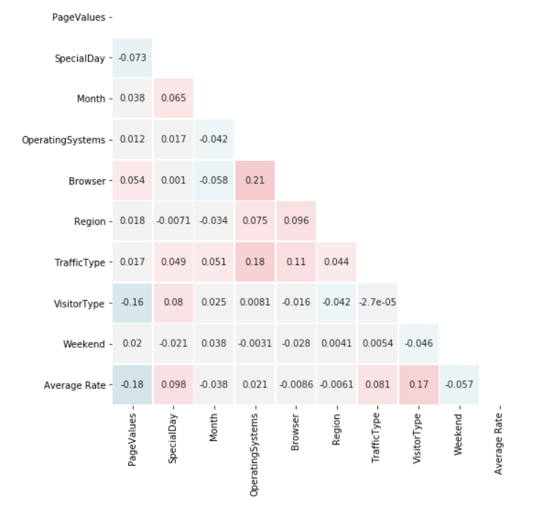
Data Preparation
Up-sampling the Minority Class
Feature Engineering
85%
70%
10422
10422
30%
2558
15%
1908
1908
False
True
False
True
Before Up-sampling
After Up-sampling
With Bounce and Exit rates
With Average Rate
Business Understanding
Evaluation
Deployment
Data Understanding
Data Preparation
Modelling
Notes:
Our target variable, Revenue, is slightly imbalanced. We have used randomized up-sampling to change the distribution by up-sampling the minority class (From 85%-15% to 70%-30%)
As you can see here, Bounce Rate and Exit Rate have a correlation of 0.91, so we took the average of Bounce rate and Exit rate due to the similar information they represent.
- Jie

Slide 8
Model Building​
Balanced Dataset
Take Square Root of
- “Page Values”
- “Average Rate”
- “Special Days”
Balanced Dataset
Transformed Dataset
Standardize X
Standardize X
Decision Tree
K-NN
Logistic Regression
Decision Tree
K-NN
Logistic Regression
Parameters:
criterion = “entropy”
max_depth = None
min_samples_leaf = 1
Parameters:
n_neighbors = 19
weights = “distance”
Parameters:
c = 1e-4
penalty = “l1”
Parameters:
criterion = “entropy”
max_depth = None
min_samples_leaf = 1
Parameters:
n_neighbors = 19
weights = “distance”
Parameters:
c = 1e-5
penalty = “l2”
Business Understanding
Evaluation
Deployment
Data Understanding
Data Preparation
Modelling
Notes:
Patrick
Thank you, Jie.
For the modeling process, we decided to use both the original dataset and the transformed dataset to see if we could improve the performance and scalability of the models. The algorithm we used are Decision Tree, Logistic Regression, and k Nearest Neighbors. We also use grid search for model tuning to find the optimal parameters of the three models. Here are the optimal parameters from our grid search.

Slide 9
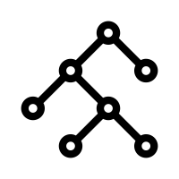

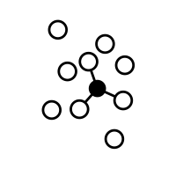

Model Evaluation using transformed variables – At a glance
Criterion
Decision Tree
Logistic Regression
kNN
Naive
Accuracy
0.90
0.86
0.91
0.7
F1-Scoreavg
0.89
0.76
0.88
-
AUC
0.91
0.88
0.96
-
Computational Power
Medium
Low
High
None
Interpretability
High
Low
Medium
High
Business Understanding
Evaluation
Deployment
Data Understanding
Data Preparation
Modelling
Notes:
- Patrick
Now we want to compare which model performs the best, and we observed that both Decision Tree and KNN perform good on the accuacy rate and F1-score. They beat the logistic regression and Naïve rule, but still, who's the final winner?

Slide 10
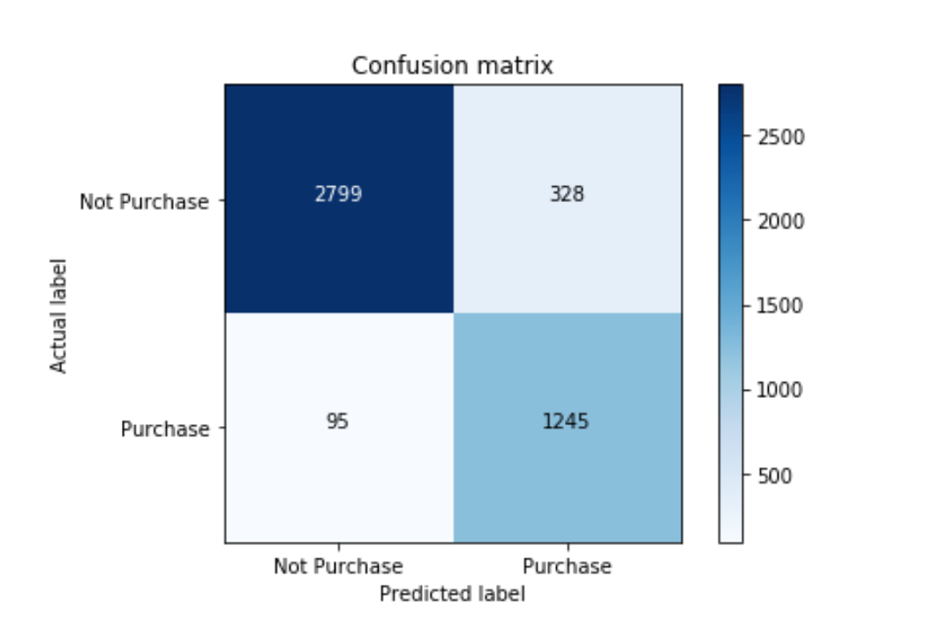
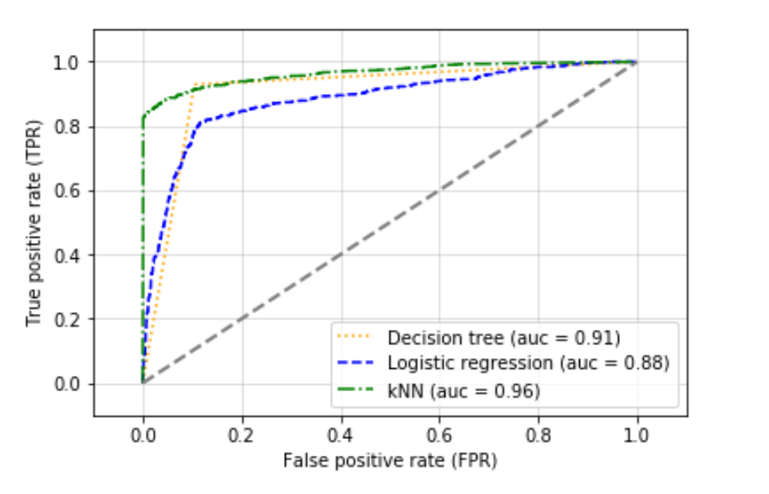
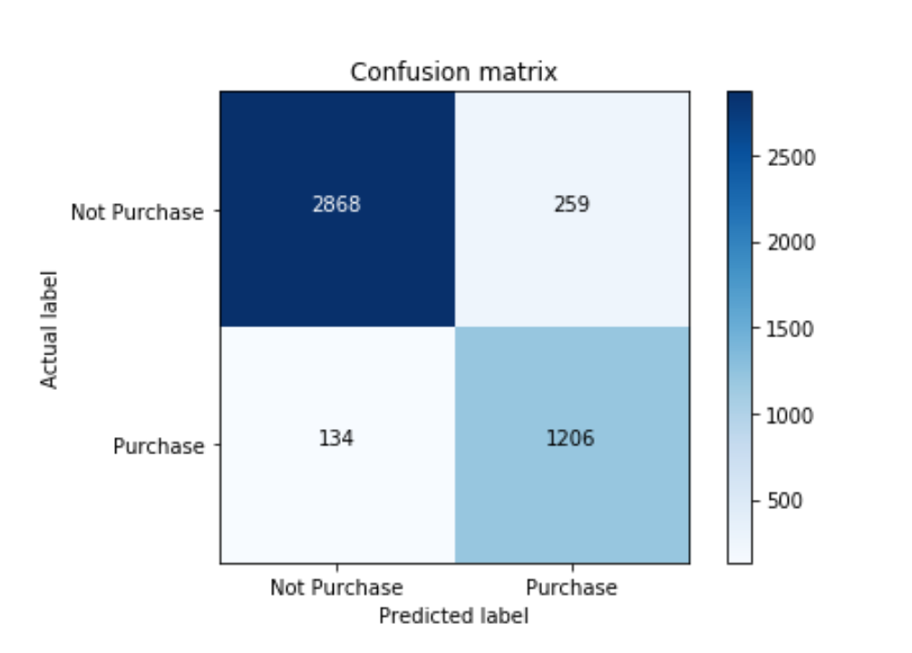
Model Evaluation​
Confusion Matrix - Tree
ROC Curve
Decision Tree – Minimizes FNs
Accuracy: 90%
Precision: 88%
AUC: 91%
Recall: 91%
F-Measure: 89%
KNN –
Minimizes FPs
Accuracy: 91%
Precision: 81%
AUC: 96%
Recall: 84%
F-Measure: 88%
So which model should we deploy?
Choosing the ideal model depends on the deployment plan, which in turn depends on which model can help us maximize revenue
Confusion Matrix - KNN
Business Understanding
Evaluation
Deployment
Data Understanding
Data Preparation
Modelling
Notes:
- Patrick
We then test how well the two models distinguish between different classes.
We can see the two models have different focus, as the Decision Tree minimizes the False Negative rate, and the KNN has the smallest False Positive rate, it looks we need to take a deeper look at our business stratergy to decide which one should we use as the final model.

Slide 11


Sample Deployment Strategy and Expected ROI
ROI Analysis – Show me the money
The confusion matrix for DT on test data:
Browsers – Impulse Purchase Strategy
 | No Purchase_{Predicted} | Purchase_{Predicted}
No Purchase_{Actual} | 2799 | 328
Purchase_{Actual} | 95 | 1245
Offer discounts early in the session and keep a time cap: e.g. Purchase within the next 30 minutes!
Engage customer & collect data: If un-availed, collect feedback on why a purchase wasn’t made
Profit Matrix: Assumptions
Conversion rate for additional transactions : 10%
Increase in AOV: $50
Cost involved in providing a discount that got availed: $10
Buyers – Cross-selling and Upselling
 | No Purchase_{Predicted} | Purchase_{Predicted}
No Purchase_{Actual} | $40 (Impulse purchase) | $0
Purchase_{Actual} | -$10 | $40 (Upselling/ Cross-selling)
Aim to increase Average Order Value (AOV) by
Upselling: Recommend more premium products
Cross-selling: Recommend additional products
ROI using these strategies = [[(2799 * $40) + (1245 * $40)] * 10% conversion rate] - (95*10$) = $15,226
Business Understanding
Evaluation
Deployment
Data Understanding
Data Preparation
Modelling
Notes:
Thanks, Patrick
There are two key questions that we need to answer: First, which strategy should we apply for each segment, and how much money can we make using that strategy?
Second, as Patrick mentioned, which model would help us do that? Turns out, minimizing false negatives is of utmost importance.
As we have seen before, offering exclusive, time-dependent discounts to buyers early in the session can make them make an Impulse Purchase. Similarly, recommending premium products or complementary products to Buyers can make them increase their Average Order Value.
With that in mind, let’s see how much money with a decision tree model:
On the top right we have the confusion matrix for the decision tree model, and on the bottom right we have a combined profit matrix
Let’s go over each number one by one.

Slide 12
Deployment Considerations and Risk Mitigation
Potential risks involved and how to eliminate/reduce them
Loss of Revenue
Loss of Customers
Ethical Risks
We lose money every time we predict a buyer as a browser.
By offering discounts to someone who would have purchased the product anyway, we lose money
Our aim is to preserve f1 score but also minimize FNs
A PILOT program is necessary.
Target only a percent of predicted browsers
Of those that are not targeted, collect data on outcome
Calibrate model
Offering discounts and special offers is helpful in gaining a bigger customer universe
In the long term, however, customers may get dependent on receiving special offers to make purchases
Such strategies should be used in shorter terms to gain popularity, but should be combined with other strategies in the long term
When looking at upselling or cross-selling for buyers, recommendations must be provided using unbiased ways
For instance, recommending products that are authentic is important.
Maximizing profit by cross-selling poor-quality products with high profit margins is neither ethical nor successful in long term
Business Understanding
Evaluation
Deployment
Data Understanding
Data Preparation
Modelling
Notes:
- Harshit

Slide 13
Process Recap
Business Understanding
Data Understanding
and Preparation
Modeling and Evalution
Business Deployment
Why is conversion rate low?
Who are our target customers?
What can we do to increase their purchase intention?
Data Source
Data Types
Up-sampling the Minority Class
Data Selection
Remove Data Leakage
Feature Selection
Data Transformation
Compare multiple classification models
Minimize False Negatives (FNs) and preserve F-1
Evaluate ROI if deployed
Solution to overcome low conversion rate?
How to mitigate risk?
Notes:
Barbara

Slide 14
Thank You
Questions?
Notes:
- Barbara

Slide 15
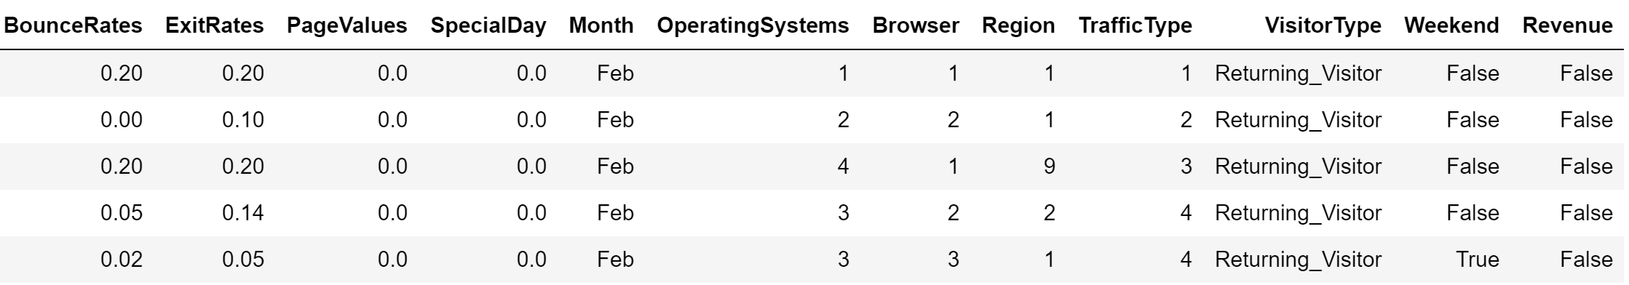
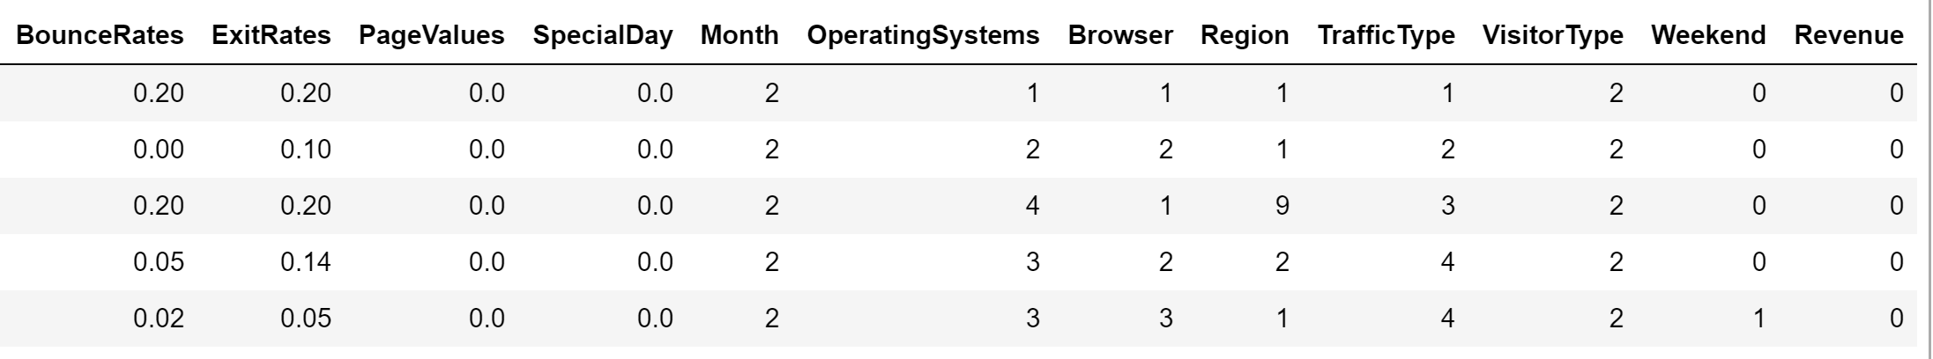
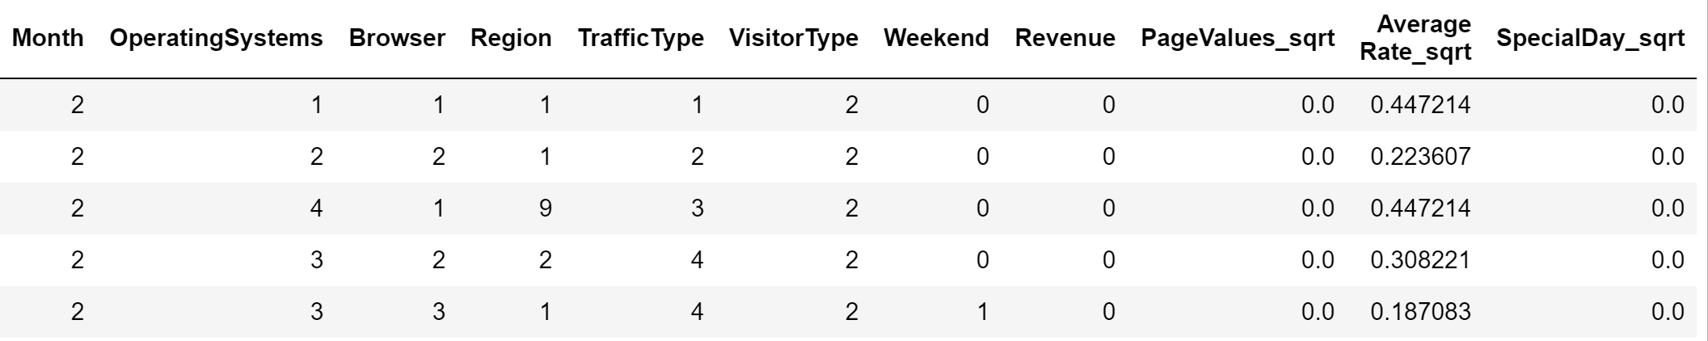
Appendix 1: Dataset: Before and after cleaning and transforming variables
Dataset after removing leakage variables
Dataset after using label encoder to transform text categories to numbers
Dataset after transforming 3 variables to square root and taking average of Bounce Rate and Exit rate as Average rate

Slide 16
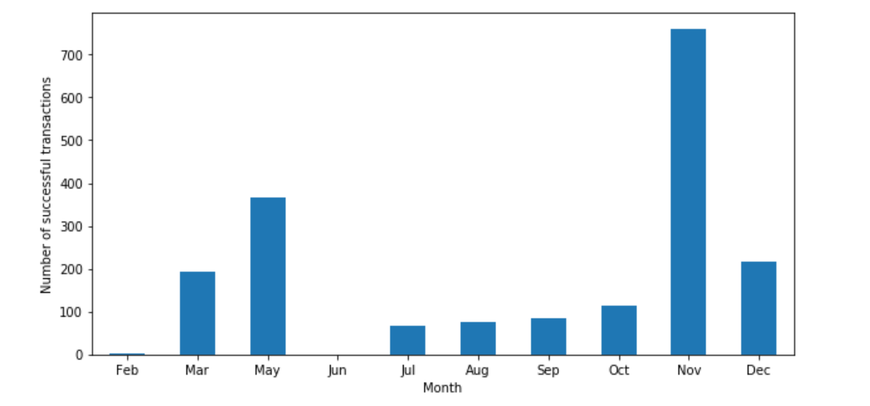
Appendix 2: Sales by month
Insights:
Highest number of sales in the month of November, while low sales in Feb and June
It is important to note that we have data for 10 months. i.e. we are missing data for Jan and April

Slide 17
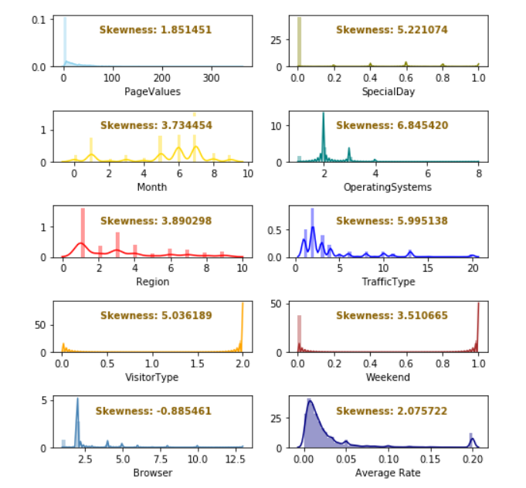
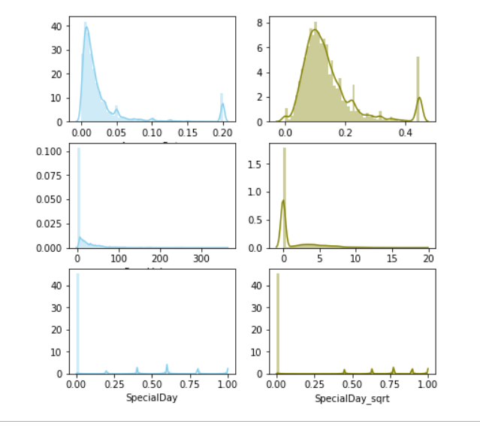
Appendix 3: Skewness and Data Transformation
Skewness of the Prepared Dataset
Skewness of the Transformed Dataset

Slide 18
Appendix 4: Correlation Heatmap
Correlation table the Original Dataset
Correlation table after feature engineering

Slide 19
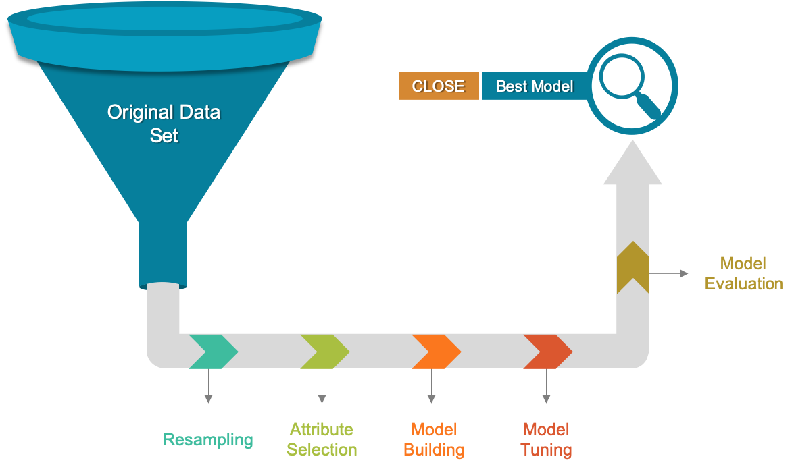
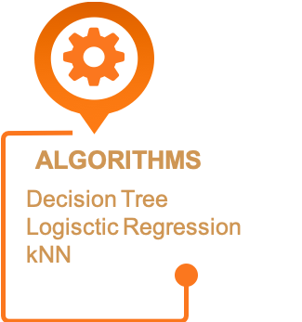
Appendix 5: Modeling Process
Business Understanding
Evaluation
Deployment
Data Understanding
Data Preparation
Modelling

Slide 20
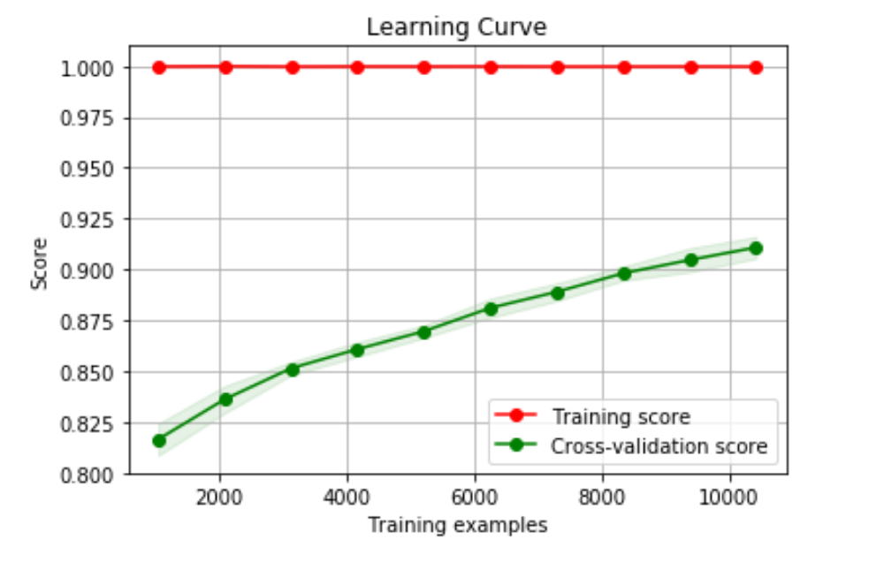
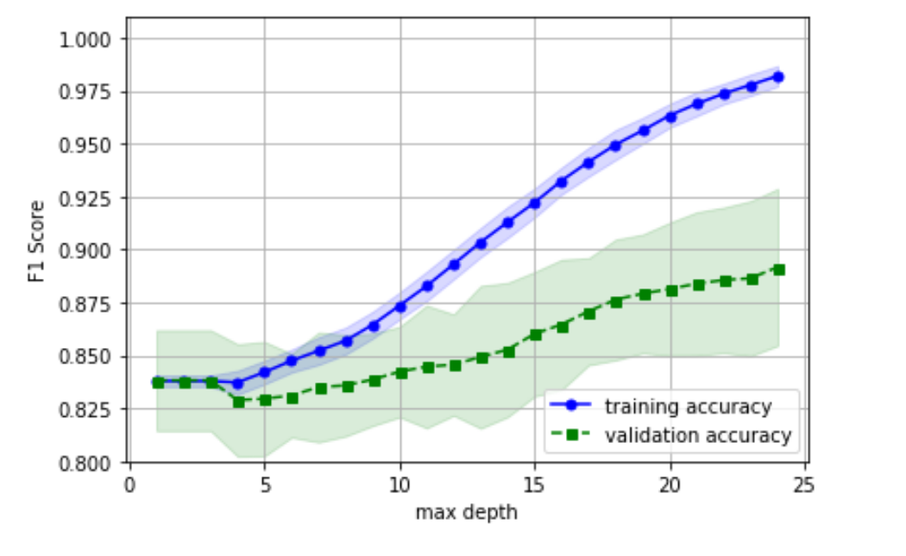
Appendix 6: Modeling Evaluation – Learning Curve and Fitting Graph
Generalization Performance
The accuracy rate for training set remain 1 because the max depth is not limited. We could observe the gap is shrinking as the training example increases, suggesting there might be more improment from additional data.
After reaching tree_depth 25, the model produces F1 score close to the optimized model, and we may consider stop adding depth in case the overfitting problem is worsen.
Learning Curve
Fitting Graph
Business Understanding
Evaluation
Deployment
Data Understanding
Data Preparation
Modelling
Notes:
- Patrick
Now we want to test the generalization performance of the model again amount of training data used and model complexity. The learning shows the gap between training and validation is shrinking as the data input increases, suggesting there might be more improvement from additional data. And from the fitting graph, we realize we may consider stop adding depth when the score close to what the optimized model produced, in case we worsen the overfitting problem.

